Slide 1

Hiring Process Analytics trainity Project #4
By:
Anurag Changmai
Data Analytics trainee

Slide 2
Project Description
The process of hiring employees is perhaps one of the most integral parts of running a venture. It simply adds the feet to the shell that is the organization and ensures it runs smoothly and consistently.
While performing hiring, an organization obtains a huge amount of data that it has to filter in order to select the best candidate/s for a role/s. This, in turn, brings in data analysts, who can help analyze and streamline the process to make it efficient and fruitful.
In this project, I analyze the hiring trends of a hypothetical organization to answer probable questions. In doing so, I utilize the tenets of statistics to obtain an overall view of certain data points, which will help the organization affect its hiring processes.

Slide 3
Approach
This project begins by first obtaining a sample hiring dataset of the organization, that carries data for 4 months in 2014, with parameters such as application ID, interview dates, hiring status, gender of the applicant, department-specific data, and salaries offered.
This data is then cleaned before being used, and outliers are removed for a clearer, non-skewed picture of the hiring process. For better clarity, data is represented in a tabular form and a chart form wherever possible.

Slide 4
Tech-stack used
In the execution of this project, the following software was used:
1. Microsoft Excel 2019 v2305
→ It was used to understand the data, which was in XLSX format, clean it, filter it, obtain results from it, and display the same in tabular and chart forms.

Slide 5
Insights
Over the next few slides, I will try to obtain insights on:
1. the gender perspective of hiring i.e. how many males and females were hired,
2. average salary value offered to all interviewed candidates,
3. class intervals for the salaries offered by the organization,
4. department-wise share of employees, and
5. post-wise share of employees

Slide 6

1. No. of males and females hired
This data is found by filtering the male and female candidates who were hired. For this, I used the COUNTIFS function provided in Excel. The formulae used for both cases and their results are provided below:
=COUNTIFS(C:C,"Hired",D:D,"Male")
=COUNTIFS(C:C,"Hired",D:D,“Female")
Here, columns C and D contain the hiring state data and gender data respectively. Results show 2563 males and 1856 females were hired in the specified timeframe.

Slide 7

2. Average salary offered to candidates
For this, the provided data is segregated into two groups: one that provides the averages of the salaries offered to hired candidates, and another that provides the averages of the salaries hired to all candidates, irrespective of their hiring status. The formula used for this operation is:
=AVG(G:G)
Where G is the column containing the salary data of all candidates. This yields the results as the average salary offered to all candidates @ 49983.02902 and to all hired candidates @ 49752.8961.

Slide 8
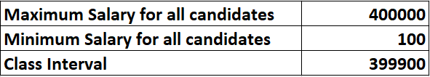
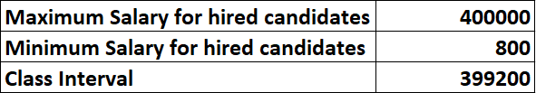
3. Class intervals of all offered salaries
The class interval value is the difference between the highest and the lowest values of any parameter, which in this case is salary. Similar to the previous data point, class intervals for both groups (all candidates and only hired candidates) are obtained. The formulae used for this operation are:
=MAX(G:G) and =MIN(G:G)
Where G is the column containing the salary data of all candidates. In this case, we also have to remove the outliers to obtain a clearer picture. Hence, all amounts below 800 and above 100,000 have been filtered out. This yields the results as below:

Slide 9
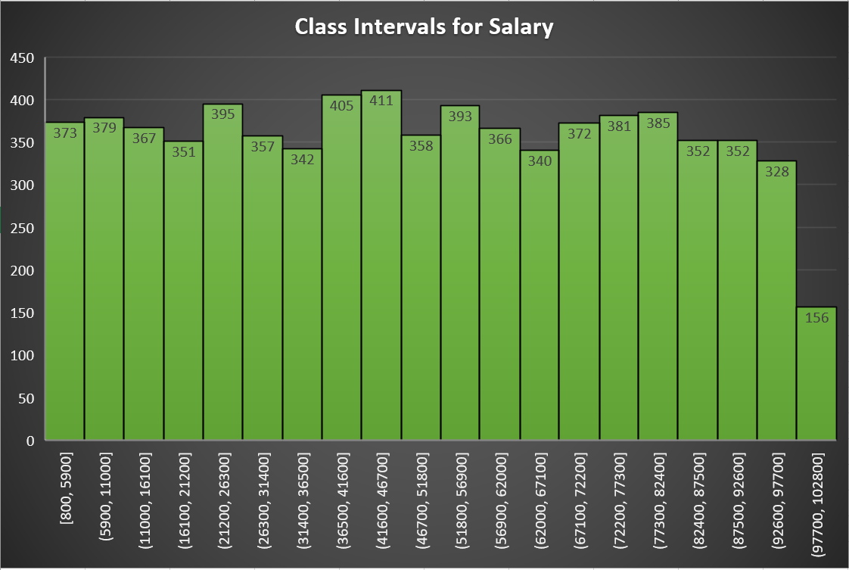
3. Class intervals of all offered salaries (Cont.)
The histogram on the right depicts the class intervals for the salaries offered to all candidates, irrespective of whether they were hired or not.

Slide 10
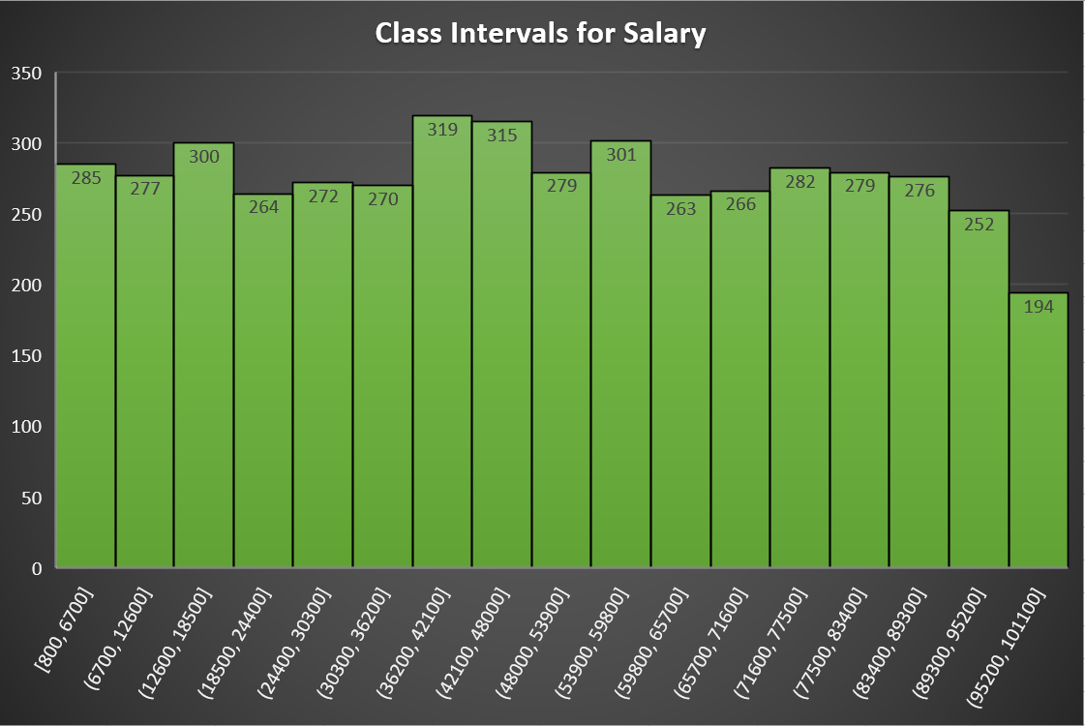
3. Class intervals of all offered salaries (Cont.)
The histogram on the right depicts the class intervals for the salaries offered to only the hired candidates.

Slide 11
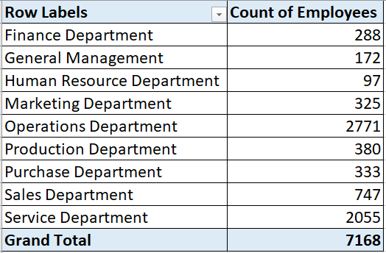
4. Department-wise share of employees
The Pivot Table on the right shows the division of all hired employees into their respective departments.

Slide 12
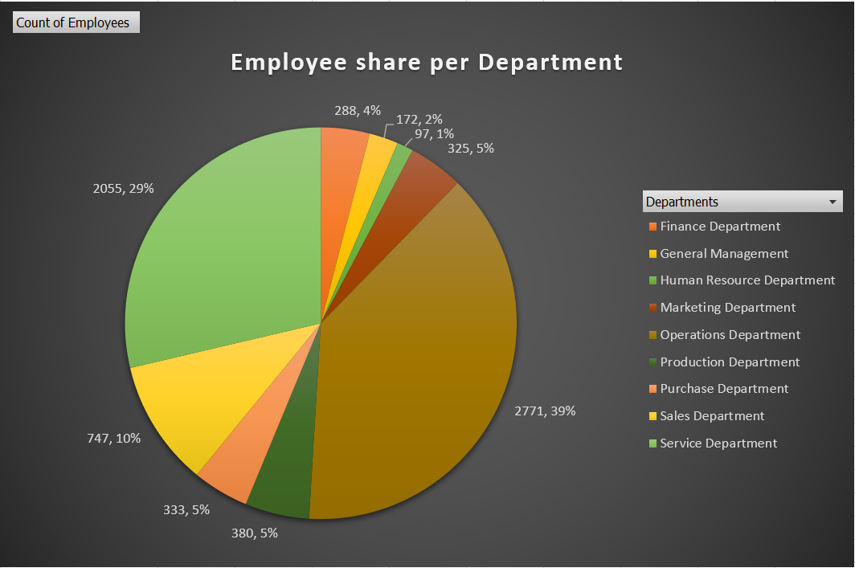
4. Department-wise share of employees (Cont.)
The pie chart on the right shows the division of all hired employees into their respective departments.

Slide 13
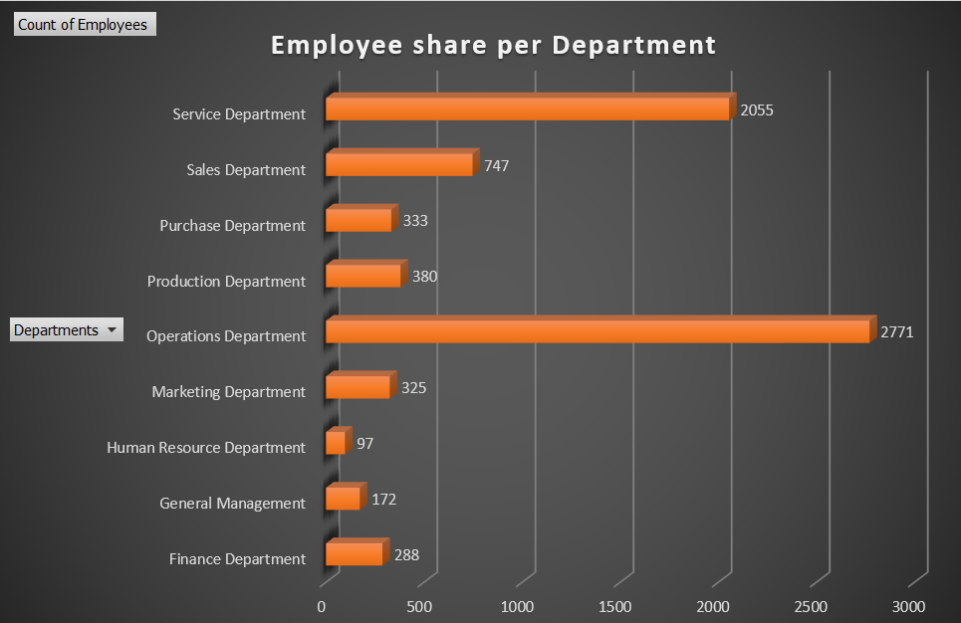
4. Department-wise share of employees (Cont.)
The bar graph on the right shows the division of all hired employees into their respective departments.

Slide 14
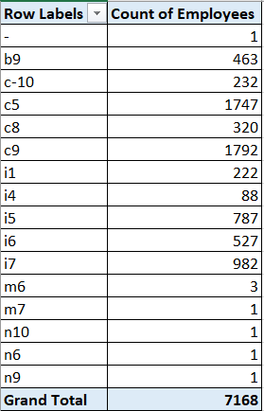
5. Post-wise share of employees
The Pivot Table on the right shows the division of all hired employees into their respective posts.

Slide 15
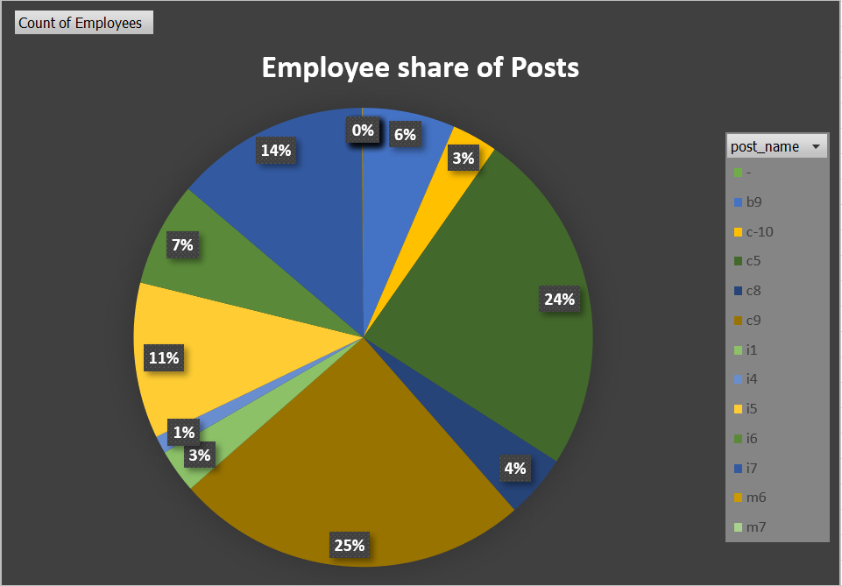
5. Post-wise share of employees (Cont.)
The pie chart on the right shows the division of all hired employees into their respective posts.

Slide 16
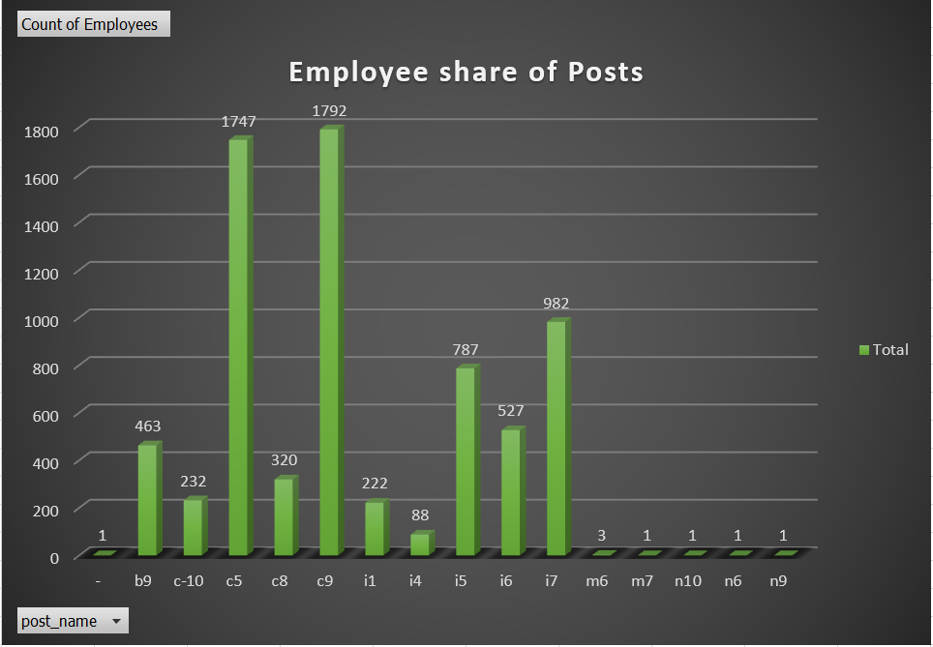
5. Post-wise share of employees (Cont.)
The bar graph on the right shows the division of all hired employees into their respective posts.

Slide 17
Result
Based on the insights provided here, the organization can aim to hire more number of female employees to create a work environment of equal representation. In doing so, the pay band of 36200-48000 can be set as it has seen the most hires.
Moreover, the organization can shift its focus from the Service and Operations departments as they have a significantly higher number of employees compared to the remaining departments. Additionally, the organization can also take a look at its post-wise hiring and create opportunities in the posts with low hiring rates.
This project has been instrumental in creating an understanding of statistics and an awareness of its usage as a data analyst. It showed how a data analyst must be proficient in statistics to provide insights that matter.

